Slide 1
Data Mining for Entity Relationship Associations School of Engineering and Applied Science Department of Computer Science CSCI 6443– Data Mining
Professor: A. Bellaachia
Student: R. Gross (G47667332)

Slide 2
Problem Definition
Many chatbots are a combination of expert systems and machine learning.
A knowledge base is often used as the “brain” of the chatbot due to its ability to perform inference.
Traditionally knowledge bases perform inference based on inference rules, which are brittle and don’t scale well.
Jena
has
Inference!
Child
is a
Parent
IF <subject> has Child
THEN <subject> is a Parent

Slide 3

Problem Definition Continued
Unsupervised learning of entity relationships is difficult and supervised learning datasets are costly to create.
Performance is subjective and language dependent.
State-of-the-art NLP algorithms struggle to perform Relationship Extraction (RE) with the precision and recall of a person.
https://corenlp.run/

Slide 4
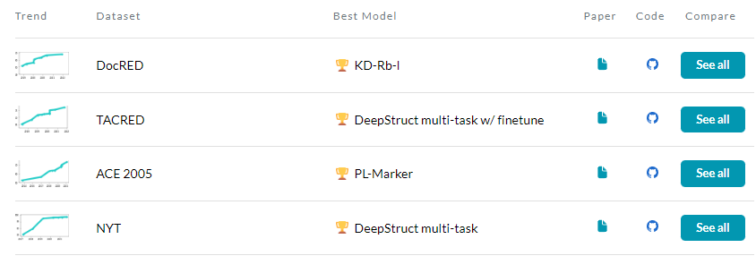
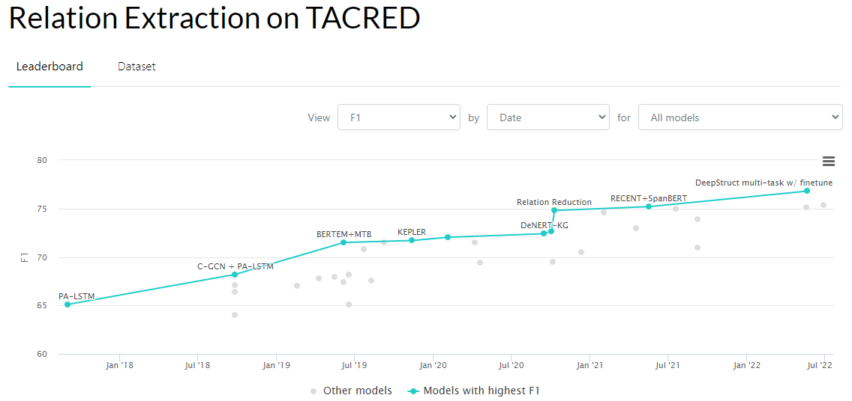
Related Work
Datasets (not all are free):
https://paperswithcode.com/datasets?task=relation-extraction
Papers:
https://paperswithcode.com/task/relation-extraction#papers-list
Notable Algorithms Types:
Long Short-term Memory (LSTM)
Graph Convolutional Neural Network (GCN)
Transformers
https://paperswithcode.com/task/relation-extraction

Slide 5
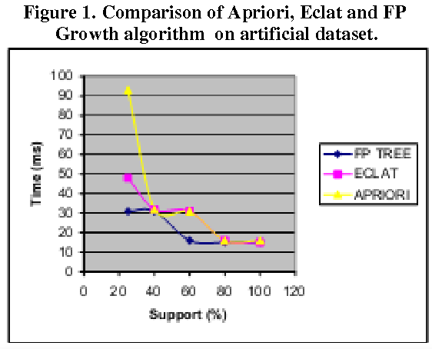
Related Work Continued
After RE, associations between relations occurs.
Leading association algorithms are:
Apriori
FP Growth
Eclat
https://research.ijcaonline.org/volume69/number25/pxc3888502.pdf

Slide 6





Proposed Approach
Text already mined and transforming to JSON files
Zipped text moved to AWS cloud environment
This allows servers to access as needed with higher download speeds
Download data
Unzip
Split into manageable data message sizes
Publish text to queue
High performance queue
Allows consuming service to be parallel by ensuring only one consumer gets each message
Perform Relation Extraction (RE) to convert unstructured data to structured data
Write to DB
Clean, Transform, and Filter Structured Data
DB Scans and Queries
Apply FP Growth
Text Dataset
Amazon Simple Storage Service (Amazon S3)
Amazon Elastic Compute Cloud (Amazon EC2)
Amazon Simple Queue Service (Amazon SQS)
Amazon Elastic Compute Cloud (Amazon EC2)
Amazon Neptune

Slide 7
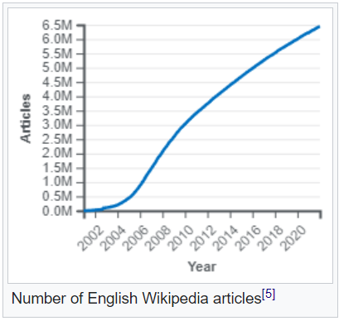
Selected Dataset
Wikipedia
6.5M+ English articles as of 2022
10TB of data as of 2015
https://dumps.wikimedia.org/enwiki/latest/
https://www.kaggle.com/datasets/ltcmdrdata/plain-text-wikipedia-202011
https://github.com/daveshap/PlainTextWikipedia
https://en.wikipedia.org/wiki/Wikipedia:Size_of_Wikipedia

Slide 8
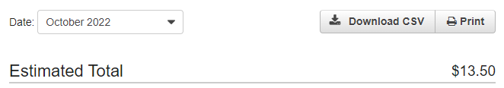
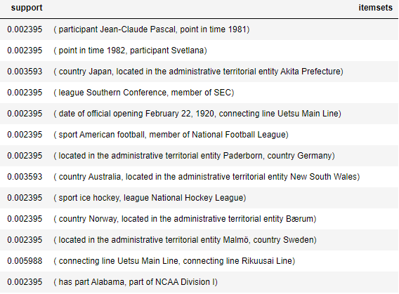
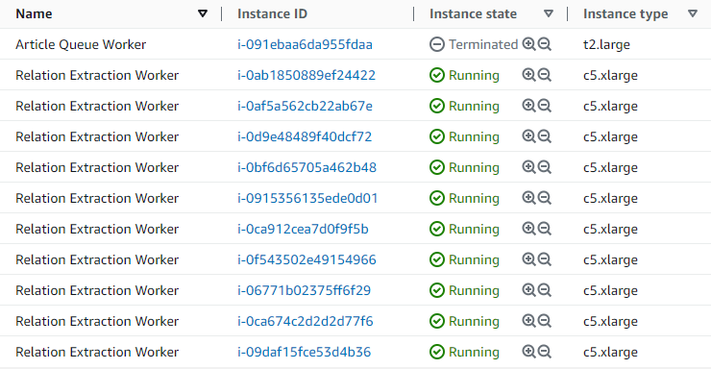
Current Progress
Some early associations
Washington Capitals
sport
Inference!
league
Ice Hockey
National Hockey League

